Slide 1
Lecture 7: Covariates

Slide 2
Discussion topics:
Types of covariates
Do-calculus
Collinearity
Structural equation models
Complementary log-log link function
Integrated SDMs

Slide 3
Types of covariates:
Density covariates
“Covariates that explain (and can predict) variation in the target variable”
E.g., habitat quality
Catchability covariates
“Covariates that explain variation among samples that are not related to the target variable”
E.g., sampling characteristics, area swept
Distinction
Both covariates are used to predict variation in available samples
Only density covariates are used when predicting densities, e.g., for use in area-weighted abundance indices
Catchability covariates are fixed at some reference value (or distribution) when predicting densities

Slide 4
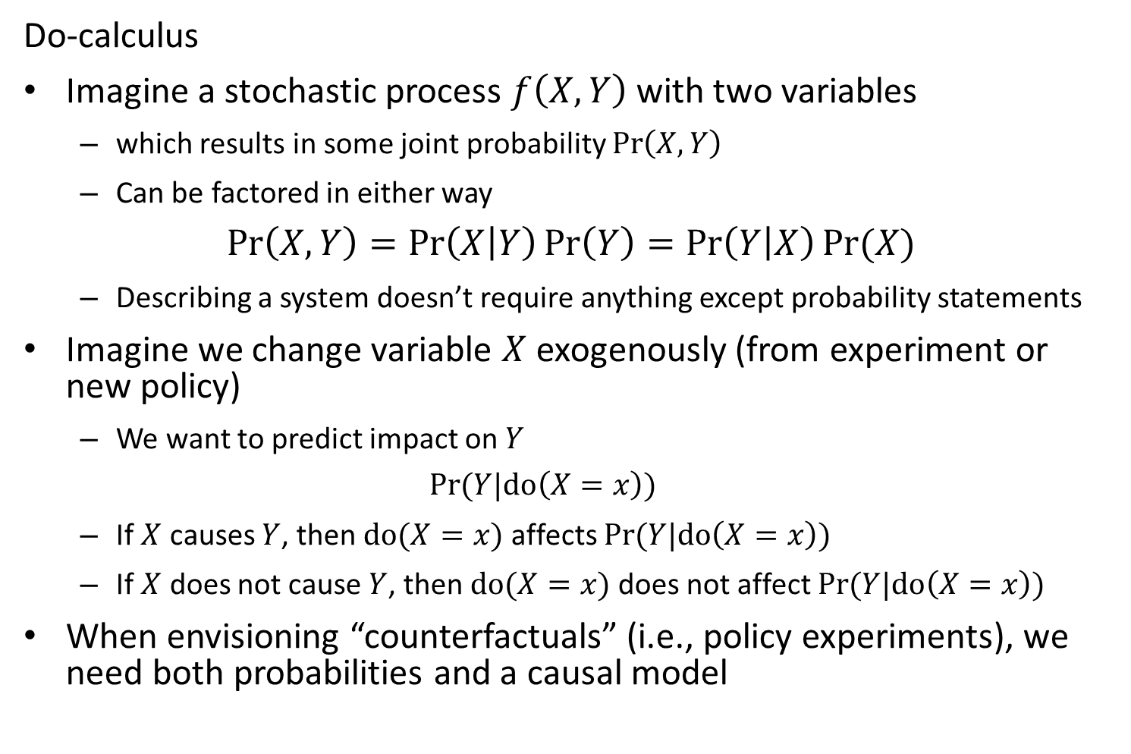
Do-calculus
Imagine a stochastic process $f\left(X,Y\right)$ with two variables
which results in some joint probability $\operatorname{Pr}\left(X,Y\right)$
Can be factored in either way
$$\operatorname{Pr}\left(X,Y\right)=\operatorname{Pr}\left(X | Y\right)\operatorname{Pr}\left(Y\right)=\operatorname{Pr}\left(Y | X\right)Pr⁡(X)$$
Describing a system doesn’t require anything except probability statements
Imagine we change variable $X$ exogenously (from experiment or new policy)
We want to predict impact on $Y$
$$Pr⁡(Y|do\left(X=x\right))$$
If $X$ causes $Y$, then $do(X=x)$ affects $Pr⁡(Y|do\left(X=x\right))$
If $X$ does not cause $Y$, then $do(X=x)$ does not affect $Pr⁡(Y|do\left(X=x\right))$
When envisioning “counterfactuals” (i.e., policy experiments), we need both probabilities and a causal model

Slide 5
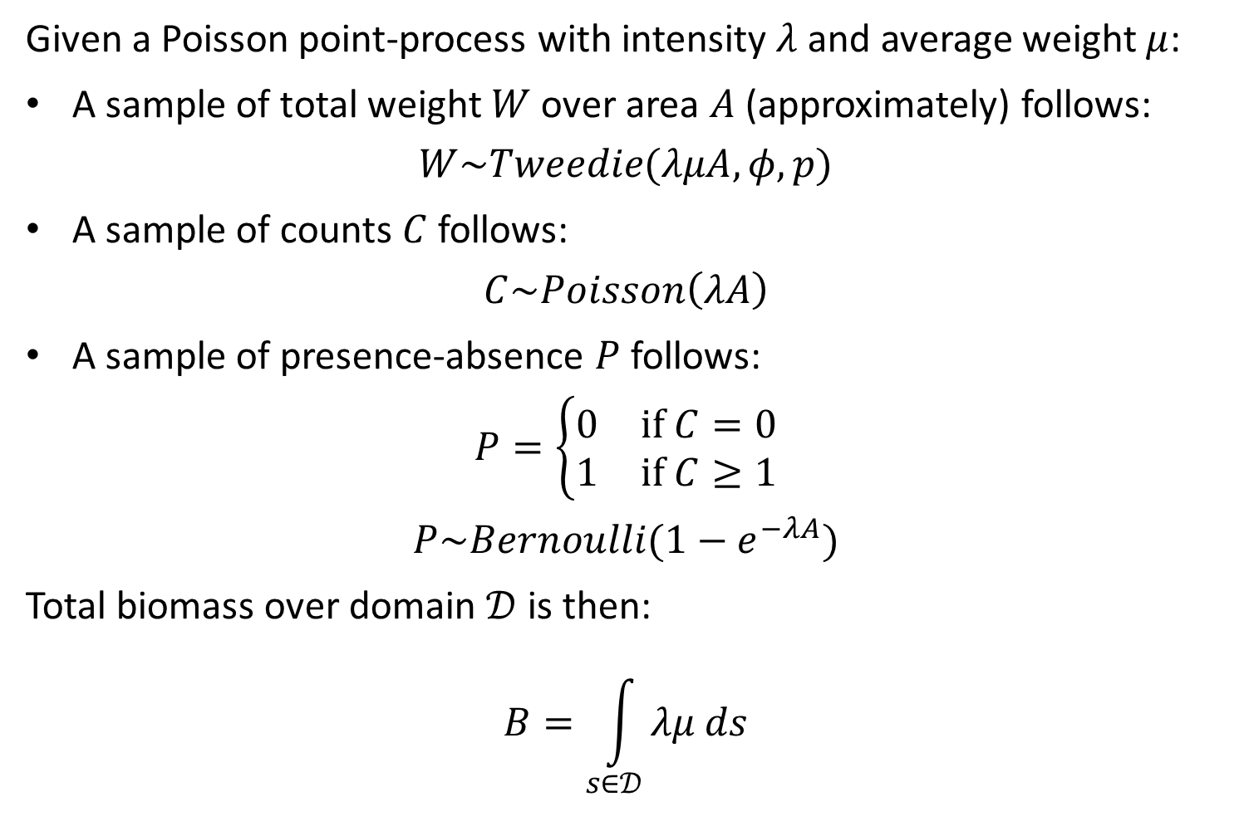
Given a Poisson point-process with intensity $λ$ and average weight $μ$:
A sample of total weight $W$ over area $A$ (approximately) follows:
$$W\sim Tweedie(λμA,φ,p)$$
A sample of counts $C$ follows:
$$C\sim Poisson\left(λA\right)$$
A sample of presence-absence $P$ follows:
$$P=\left\{\begin{matrix}0 & if C=0 \\ 1 & if C≥1\end{matrix}\right.$$
$$P\sim Bernoulli(1−e^{−λA})$$
Total biomass over domain $𝒟$ is then:
$$B=\int_{s∈𝒟}{λμ ds}$$

Slide 6
Collinearity
Arises when predictor variables are correlated with one-another
Results in covariance in the standard errors for slope parameters for those colinear predictors
Does *not* affect results when predicting new samples that are within the range of existing data
*Does* affect results when predicting data with a new “collinearity pattern”

Slide 7
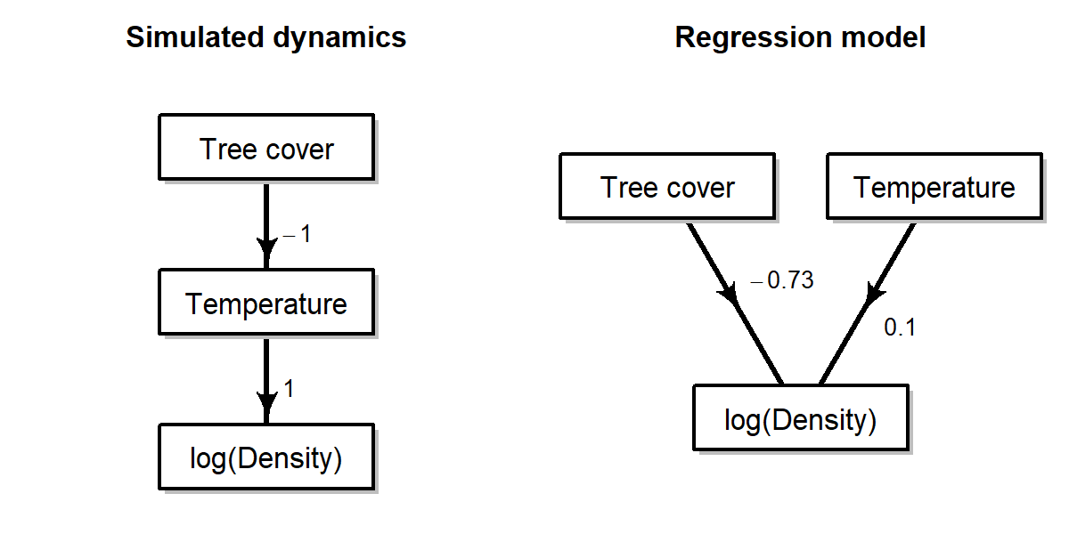
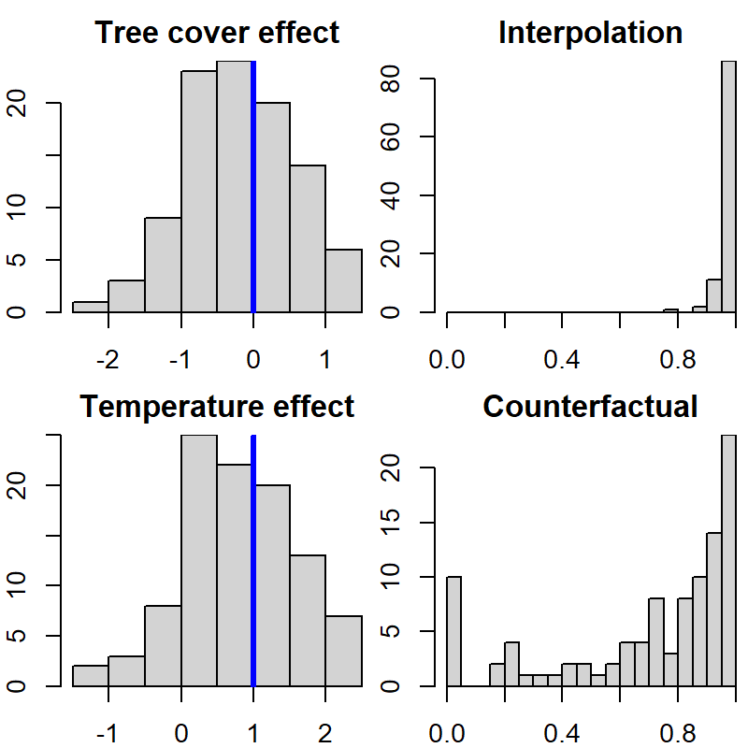
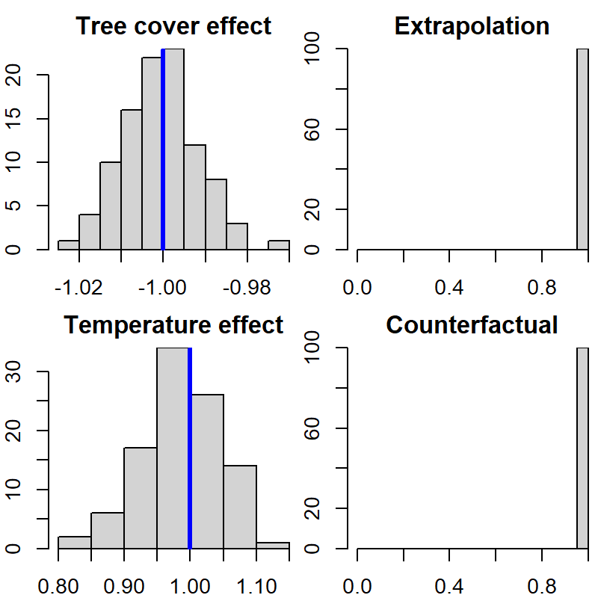
Standard regression (GLM)
Structural equation model

Slide 8

Structural equation models
Specify covariance $V$
Specify path matrix $Γ$
Solve for simultaneous equation:
$$x=Γx+δ$$
$$δ\sim MVN(0,V)$$
Re-arranging, we see that:
$$\left(I−Γ\right)x=δ \\ x={\left(I−Γ\right)}^{−1}δ$$
Such that:
$$x\sim MVN(0,Σ)$$
$$Σ={\left(I−Γ\right)}^{−1}V{\left({\left(I−Γ\right)}^{−1}\right)}^{T}$$
Or using sparsity:
$$x\sim GMRF(0,Q)$$
$$Q={\left(I−Γ\right)}^{T}V^{−1}\left(I−Γ\right)$$

